Slide 1
Group 7 - Project Milestone 1 (Medium vs Small mammals)
Ching-min Hu; Qiao Liu; Dandan Zhao; Rajasree Rajendran;
Megha Rao; Fernanda Bordin - CMPE257- Spring 2019
Notes:
‹#›

Slide 2
Presentation Outline
How the dataset was filtered to select images belonging to our assigned superclasses.
How the filtered data was validated as our assigned classes
ML algorithms used to predict this binary classification problem
Prediction scores with train-test-split
Confusion matrix and classification report
How we arrive at our results
Additional experiments done
Lesson learned

Slide 3


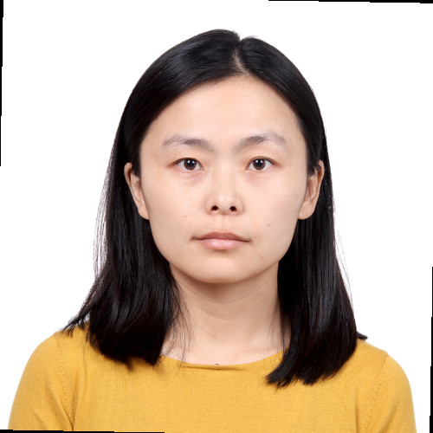
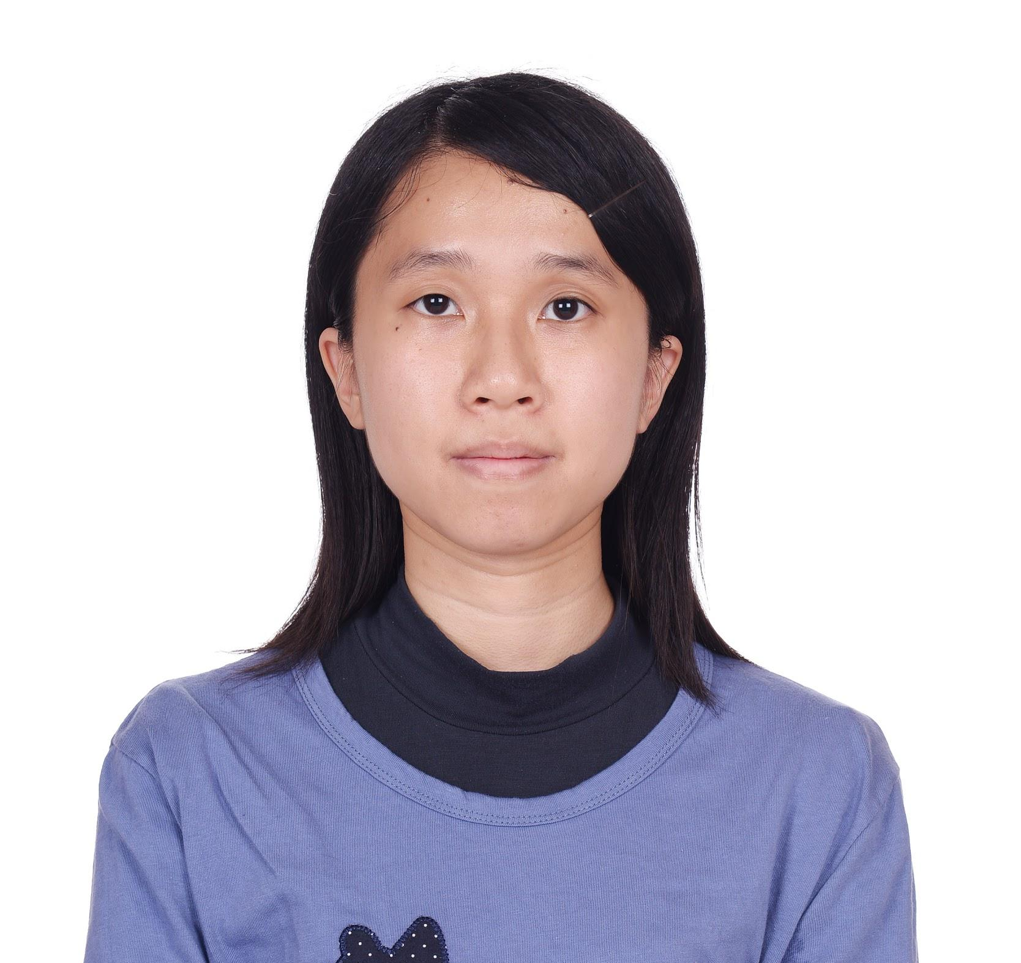


Group Members
Fernanda Bordin
Rajasree Rajendran
Dandan Zhao
Ching-min Hu
Qiao Liu
Megha Rao

Slide 4
Data Preparation
1) Work on superclass pairs - Assigned pair is Medium-sized mammals and Small mammals. Load training / testing data using cifar100.load_data(). Seed to reproduce results.
2) Combine testing and training data (17%/83%)- Swiftly merge using numpy.concatenate function.
3) Filter as per assigned superclasses - Define the fine labels, find index and splice the array using loops and enumerate function.
4) Validate the data by printing 4 randomly selected images from each sub-class - Assign verbal fine and coarse labels and plot images using matplotlib.

Slide 5
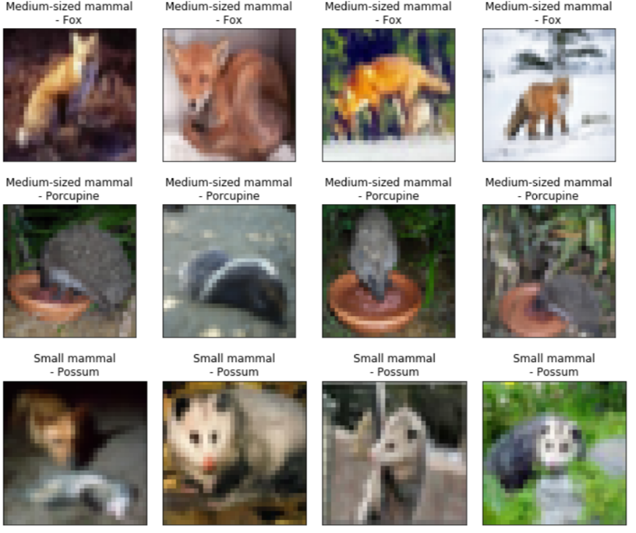
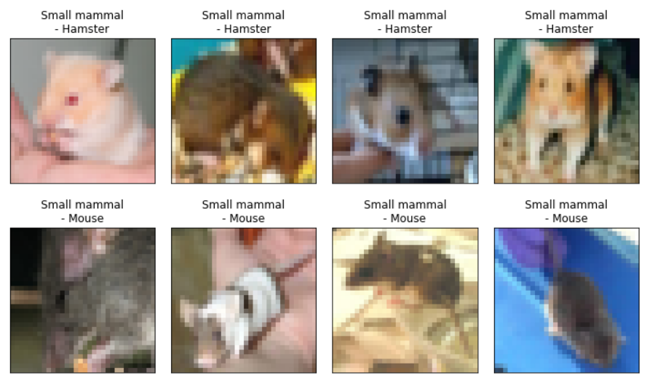

Slide 6
Machine Learning Algorithms
with default parameters
Model | score | time(s)
DecisionTreeClassifier | 58.5% | 15.559
BaggingClassifier | 61.6% | 104.556
ExtraTreesClassifier | 62.6% | 0.925
RandomForestClassifier | 64.2% | 2.008
AdaBoostClassifier | 58.3% | 66.003
GradientBoostingClassifier | 65.8% | 122.632
Notes:
score: the mean accuracy on the test data and labels. Mean accuracy of self.predict(X_test)
parameters are all default value.
train size to test size = 5 to 1.
try to use the cross validation, the result is not better.

Slide 7
Model | score | time(s)
SVM: C-Support Vector Classification with different kernels, C=5
kernel = “rbf” | 63.2% | 116.786
kernel = “poly” | 59.4% | 101.656
kernel = “linear” | 58.5% | 263.394
kernel = “sigmoid” | 59.4% | 101.656
Notes:
Degree of the polynomial kernel function, default value is 3

Slide 8
Other methods
Model | score | time(s)
Logistic Regression Classifier | 59.6% | 29.912
KNeighborsClassifier | 61.3% | 62.323

Slide 9
Train the models with tuning the parameters
Model: ExtraDecisionTree
Best parameters Found:
'max_depth': 30, 'n_estimators': 500
Score: 67%
Model: RandomForest
Best parameters Found:
'max_depth': 30, 'n_estimators': 500
Score: 65.60%

Slide 10
Train the models with tuning the parameters
Model: SVM with ‘rbf’ kernel
Best parameters Found: C=10
Score: 63.5%
Model: Logistic Regression
Best parameters Found: C=1
Score: 59.6%

Slide 11
Models Lessons learned
GradientBoostingClassifier:
high accuracy, requires careful tuning of different hyper-parameters
ExtraDecisonTree and RandomForest:
run fast, and good accuracy
SVM:
more computation effort, with the default kernel have the best accuracy

Slide 12
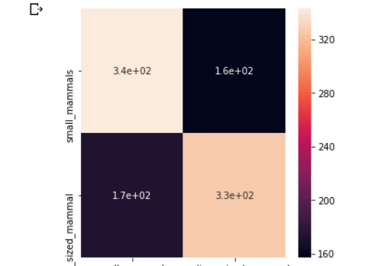
Model Evaluation---ExtraDecisionTree
Confusion matrix:
Notes:
better in predict the small mammals

Slide 13
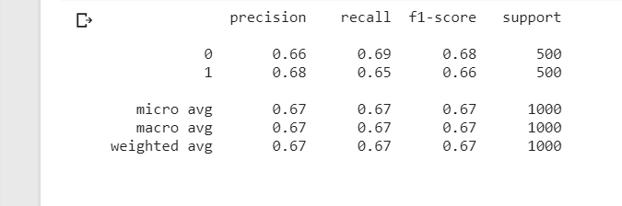
Classification report
Notes:
0: small mammals
1: medium_sized_mammals

Slide 14
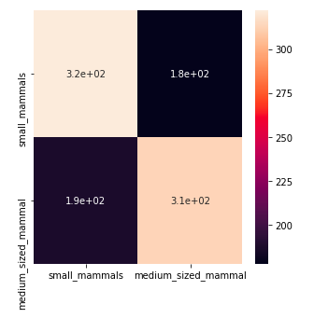
Model Evaluation---SVM with kernel = “rbf”
Confusion matrix

Slide 15
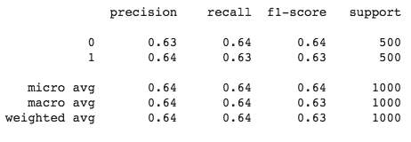
Classification report
Notes:
0: small mammals
1: medium_sized_mammals

Slide 16
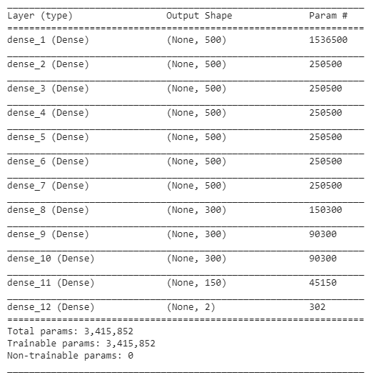
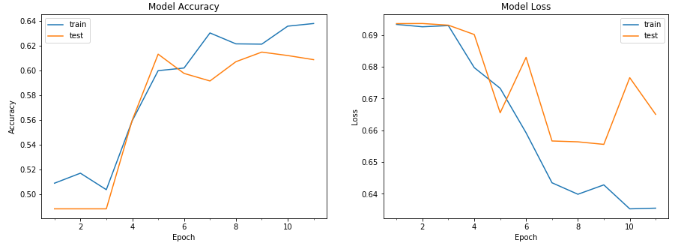
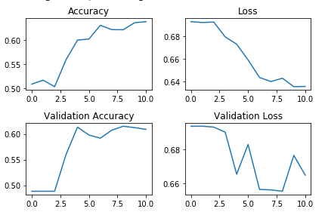
Neural network model
Initial results using a basic neural network have presented a score of 62.7%.
Through experimentation, we reached that 500 neurons was an optimal point for the density of our neural network.
We’re currently exploring what changes can be done to the model. Probably we’ll do a convolutional network.

Slide 17
Lessons learned
Neural networks
Keeping the number of neurons constant on all layers doesn’t necessarily improve the models accuracy
Rerunning the model training (fit), even after it has stops due to not improving, can indeed generate a better result

Slide 18
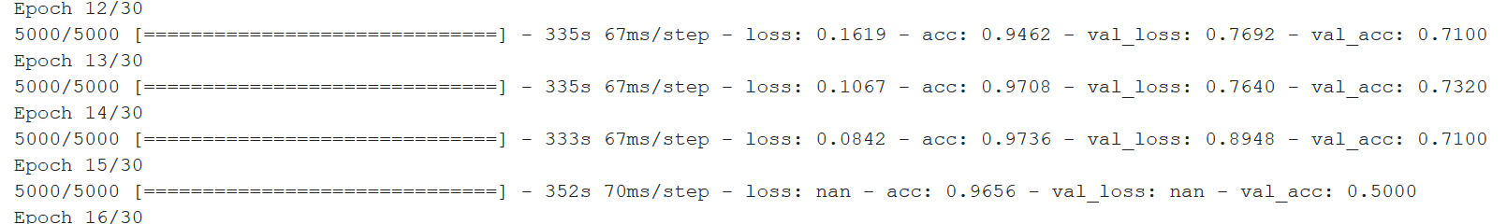
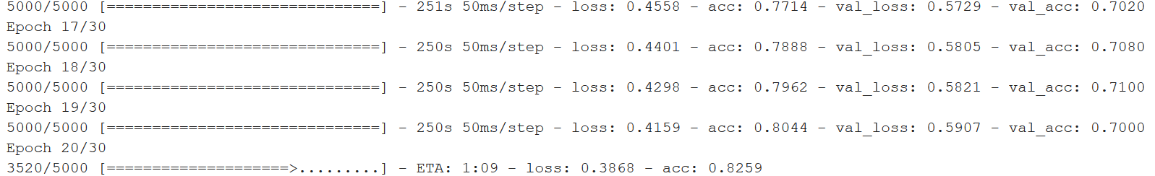
Exploring CNN
First trial: very high accuracy on the training set, lower accuracy on the test set → overfitting
Second trial: using dropout ~71% accuracy

Slide 19
Future experiments
Use confusion matrix to determine the cause of errors, go back to the dataset and search for reasons
Use Gridsearch for hyperparameter tuning for all methods
Preprocess the dataset for CNN (grayscale, cropping)

